Slide 1
InFORM Interagency Fire Occurrence Reporting Modules
2021
Notes:
New fire reporting program for BLM, NPS, USFS, State of AK
One fire report per incident YAY
Explain that FWS graciously participated

Slide 2
How did it go?
Completed and Certified 397 incidents (Wildfires and False Alarms) in 2020.
Agile development meant program changed.
System integration was new.
New business practices to learn.
Notes:
False Alarms do need to be certified and you have to filter for them.
Some bugs but overall develops fixed (causes overwriting issues, date/time conflicts)
System integration significant time savings (no retyping) but cause issues if users are not aware( use of collector, duplicate WIldCAD incidents) as well as issues with category differences (fuels, causes, etc)
New processes (people forgot to include the DM 620 or all affected jurisdictions, FMOS certifiying wrong fires)

Slide 3
New for 2021

Slide 4
Ownership Breakdown

Slide 5
Fire Reporting ADS
Should prohibit some of the overwriting that occurred last year.
HOWEVER, this is new so ???

Slide 6
Sharepoint Site

Slide 7
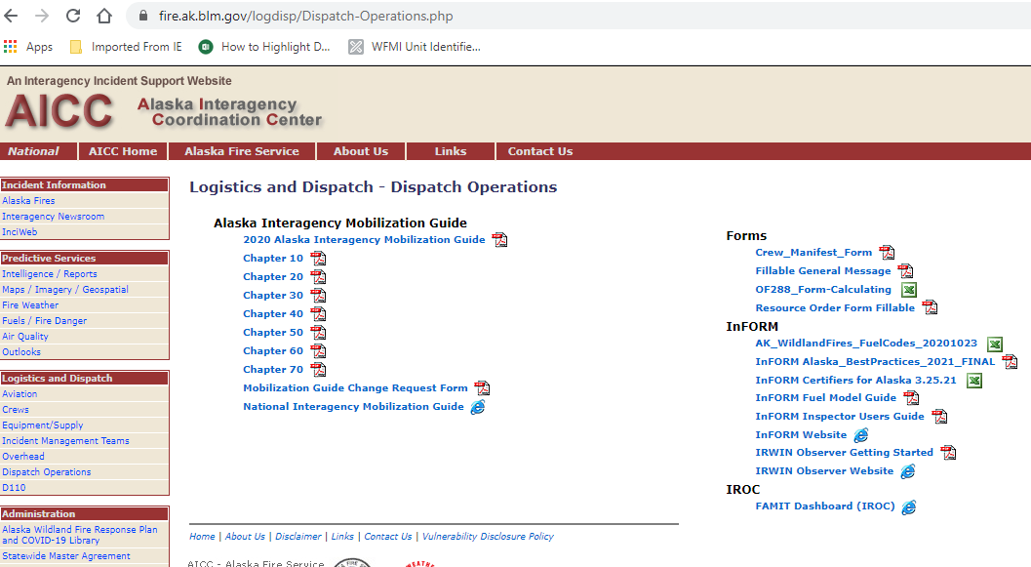
Available on website as well

Slide 8
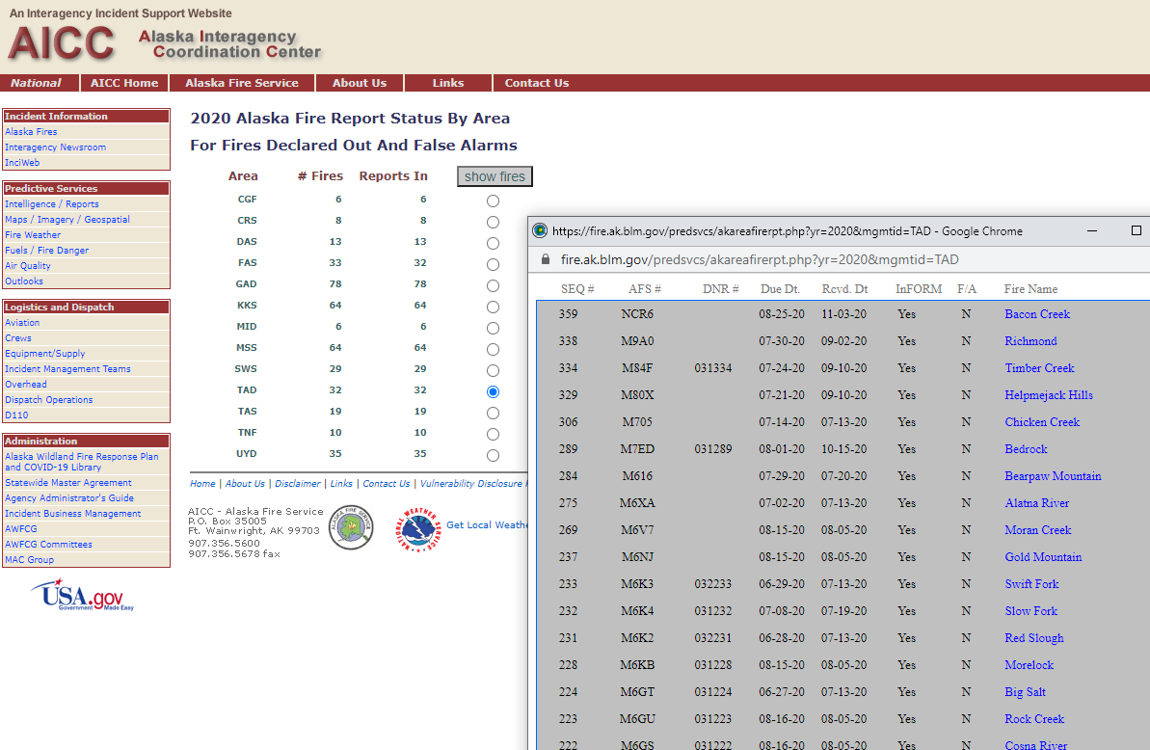
Required timelines
Report is due to Certifier(s)and DM620 rep (if applicable) 15 days after fire is called out.
Report is required to be Certified 30 days after fire is called out.

Slide 9
Questions?
Jennifer Humphrey, jhumphre@blm.gov 907-356-5690

